Slide 1












Reportradar.com
SEE IT! REPORT IT! FIX IT!
TEAM NAME: CONFUSED CODERS
Team leader: sanju kumar
TEAM MEMBERS: MANASVI MAHAJAN, PRANAY SINGH, KHUSHVEER SINGH
HACKATHON: ODOO HACKATHON

Slide 2
TABLE OF CONTENTS
01
02
Problem statement
Our solution
TECHNOLOGY STACK
03
04
KEY FEATURES
FUTURE ENHANCEMENT
05
HOW IT WORKS
06

Slide 3

Problem statement:
Many civic issues, such as potholes, garbage, and broken streetlights, go unnoticed or unreported.
Municipal authorities struggle with inefficient reporting mechanisms, leading to delays in addressing problems.
Citizens lack motivation to report issues due to lack of incentives

Slide 4
OUR SOLUTION
Instant governance
Geo-tagged reporting
incentivized Reporting
Municipal authorities receive reports in real-time
Upload images of civic issues with location details
Users are rewarded for valid reports, increasing engagement

Slide 5


KEY FEATURES

Slide 6


KEY FEATURES:
Image Upload:
Users submit images of issues.
Location Tagging:
Reports include geographic details.
Municipal Dashboard:
Authorities manage reports.
Reward System:
Users earn points for valid reports.
Report Tracking:
Users track issue status.

Slide 7
TECHNOLOGY STACK
Backend:
Storage:
Python (Flask)
Cloud or Local (for images)
Frontend:
DATABASES
HTML, CSS
SQL (SQLite/MySQL)

Slide 8
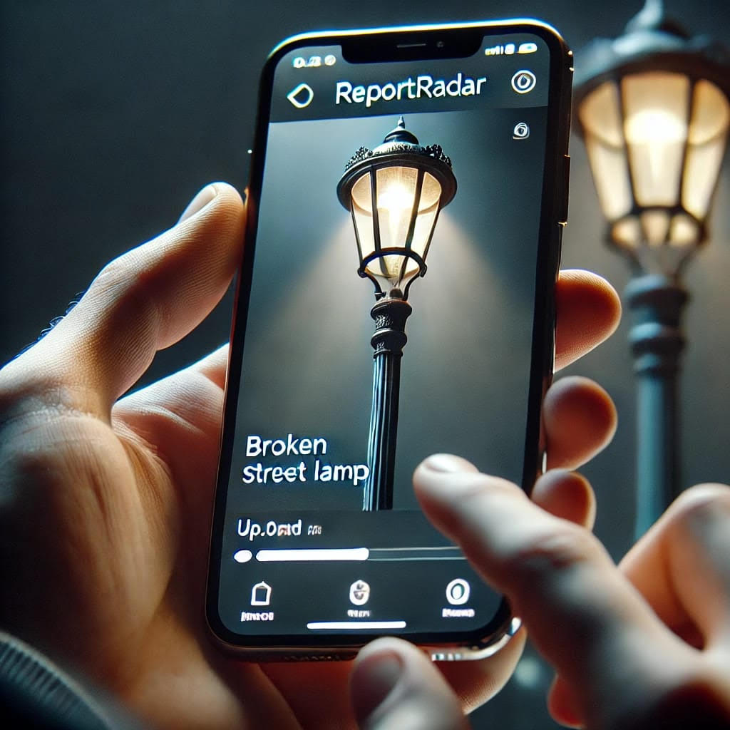
HOW IT WORKS:
STEP1 :
Authorities verify & take action.
STEP2:
Users upload issue images with location & description.
STEP3:
Data is stored and sent to municipal authorities.
STEP4:
Users earn reward points for valid reports.

Slide 9
WHY REPORT RADAR IS DIFFERNT
Uses Al (future scope) for report verification
Real-time reporting for faster issue resolution
Incentive-based model to increase participation
Open platform for all municipal departments

Slide 10
FUTURE ENHANCEMENT
Al-based report validation
Mobile App for easy reporting
Gamification to engage users
Integration with smart city initiatives

Slide 11
THANKS!
Does anyone have any questions?
2403031460881@paruluniversity.ac.in
+91 7004241345

